Slide 1
Outbrain Click Prediction
Team : 3
Mitesh Ghatnekar
Sanjoy Malik
Rajesh Sajjanar

Slide 2
Problem Statement
Predict which pieces of content Outbrain’s global base of users are likely to click on .
For each display_id in the test set, predict a space-delimited list of ad_ids, ordered by decreasing likelihood of being clicked. The candidate ad_ids for each display_id are provided in clicks_test.csv.
Note that each display_id can have a different number of associated ads.
The file should contain a header and have the following format:
display_id,ad_id….
16874594,66758 150083 162754 170392 172888 180797 16874595,8846 30609 143982 16874596,11430 57197 132820 153260 173005 288385 289122 289915 etc.

Slide 3
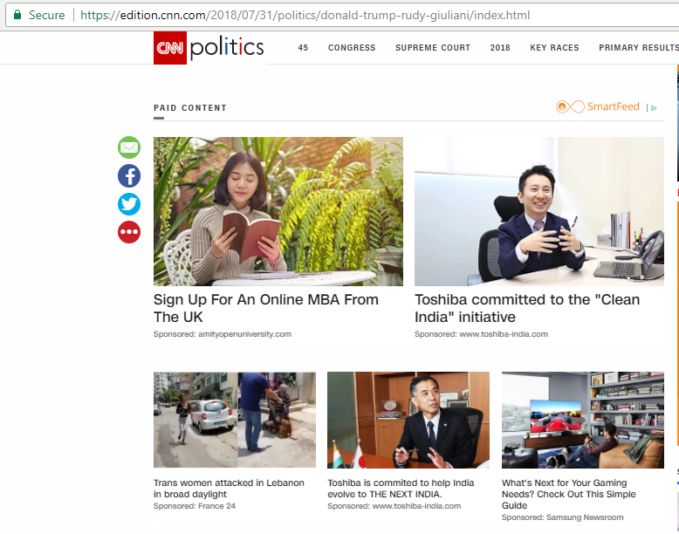
Traffic Source : Internal/Social/Search
Document
Promoted Content
Country
Ads

Slide 4
Solution Approach
Describe your pipeline : My pipeline consisted of below steps.
Analysis of Data
Visualization of Data
Feature Extraction
Merging Dataframes to get the final dataset with all the required features
Extract the display_id and ad-id ‘s in the decreasing order of likelihood of being clicked
Split data frame into random train and test subsets
Train the data by applying RandomForest Classifier
Fit the Model
Predict the Result
2. Identify potential shortcomings with your current pipeline:
Data is huge hence, we are getting out of memory error while reading the data hence we have considered 1 million records
Due to lack of time we are unable to apply other models

Slide 5
Data Files
The dataset for this challenge contains a sample of users’ page views and clicks, as observed on multiple publisher sites in the United States between 14-June-2016 and 28-June-2016
Each user in the dataset is represented by a unique id (uuid). A person can view a document (document_id), which is simply a web page with content (e.g. a news article). On each document, a set of ads (ad_id) are displayed. Each ad belongs to a campaign (campaign_id) run by an advertiser (advertiser_id). You are also provided metadata about the document, such as which entities are mentioned, a taxonomy of categories, the topics mentioned, and the publisher
Clicks_test.csv.zip
Clicks_train.csv.zip
Documents_categories.csv.zip
Documents_entities.csv.zip
Documents_meta.csv.zip
Documents_topics.csv.zip
Events.csv.zip
Page_view.csv.zip
Page_views_samples.csv.zip
Promoted_content.csv.zip
Sample_submission.csv.zip

Slide 6
DATA FILES AND ITS RELATIONSHIP
clicks_train.csv
display_id | Single valued
ad_id | Single valued
clicked | Single valued
events_csv
display_id | Single valued
uuid | Single valued
document_id | Single valued
timestamp | Single valued
platform | Single valued
geo_location | Multi-valued
page_views_sample.csv
uuid | Single valued
document_id | Single valued
timestamp | Single valued
platform | Single valued
geo_location | Multi-valued
traffic_source | Single valued
clicks_test.csv
display_id | Single valued
ad_id | Single valued
promoted_content.csv
ad_id | Single valued
document_id | Single valued
campaign_id | Single valued
advertiser_id | Single valued
sample_submission.csv
display_id | Single valued
ad_id | Multi-valued
documents_categories.csv
document_id | Single valued
category_id | Single valued
confidence_level | Single valued
documents_entities.csv
document_id | Single valued
entity_id | Single valued
confidence_level | Single valued
documents_meta.csv
document_id | Single valued
source_id | Single valued
publisher_id | Single valued
publish_time | Single valued
documents_topics.csv
document_id | Single valued
topic_id | Single valued
confidence_level | Single valued

Slide 7
DATA UNDERSTANDING
Data File and Key Details
uuid | Each user in the dataset is represented by a unique id (uuid).
document_id | A person can view a document (document_id), which is simply a web page with content (e.g. a news article).
ad_id | On each document, a set of ads (ad_id) are displayed.
campaign_id | Each ad belongs to a campaign (campaign_id)
advertiser_id | Each campaign is run by an advertiser
entity_id | It can represent a person, organization, or location
clicks_train.csv | It is the training set, showing which of a set of ads was clicked.
clicks_test.csv | It is the same as clicks_train.csv, except it does not have the clicked ad. This is the file you should use to predict. Each display_id has only one clicked ad. Note that test set contains display_ids from the entire dataset timeframe. Additionally, the public/private sampling for the competition is uniformly random, not based on time. These sampling choices were intentional, in spite of the possibility that participants can look ahead in time.
events.csv | It provides information on the display_id context. It covers both the train and test set. This dataset tells you what is happening when user clicked on some ad. You should use it with clicks_train and clicks_test as both have display_id label.
sample_submission.csv | It shows the correct submission format
promoted_content.csv | It provides details on the ads.
page_views_sample.csv | It is the sample log of users visiting documents
documents_meta.csv | It provides details on the documents.
documents_topics.csv documents_entities.csv documents_categories.csv | All provide information about the content in a document, as well as Outbrain's confidence in each respective relationship. For example, an entity_id can represent a person, organization, or location. The rows in documents_entities.csv give the confidence that the given entity was referred to in the document.

Slide 8
Prepare Data
Download data from Kaggle
Data Files Selection: Relevant data files were considered out of all the downloaded files based on analysis
Data Cleaning and Validation: The data in the files was cleaned and validated to ensure clean data is fed for next steps.
Metadata modelling: As the data is divided into various files, files were joined to create files needed for our model creation.
Users | uuid, geographic location ( → Country )
Documents | Document id, ad id, source id, publisher id, publish time, entity id & confidence level, topic id & confidence level, category id & confidence level, advertiser id, campaign id
Page View Event | display id, timestamp, platform, traffic source

Slide 9
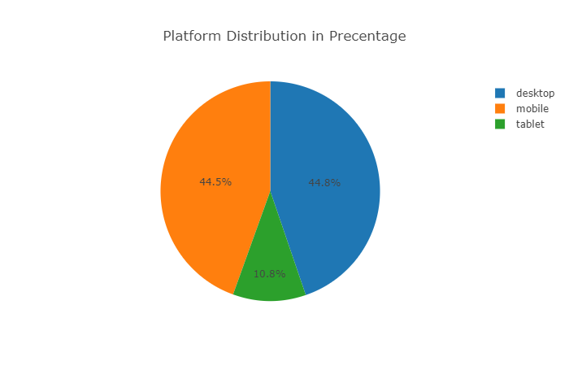
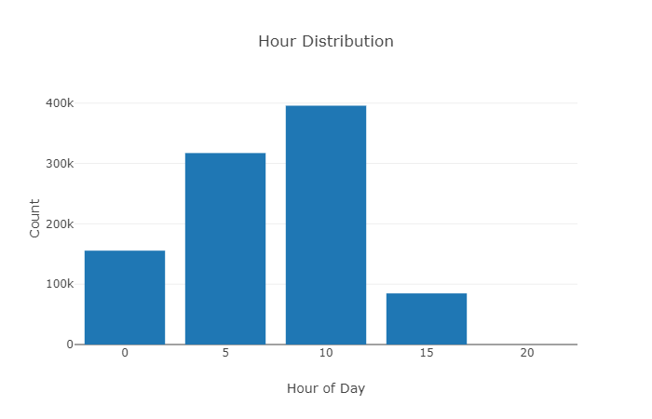
Visualize Shape Of Data on Events
Analysis of percentage of clicks across different platform’s in events table
Analysis of click frequency during different hours of a day in events table

Slide 10
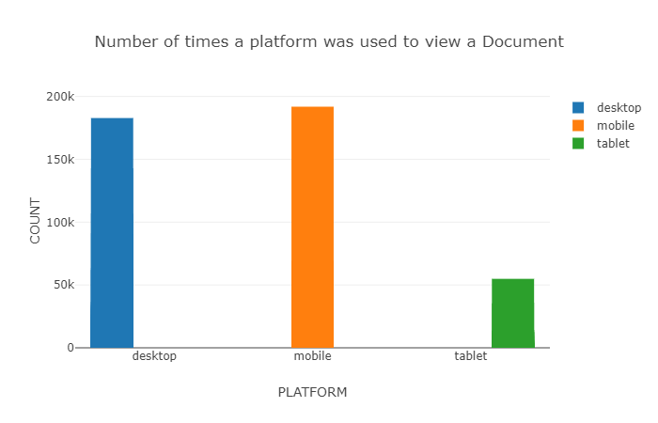
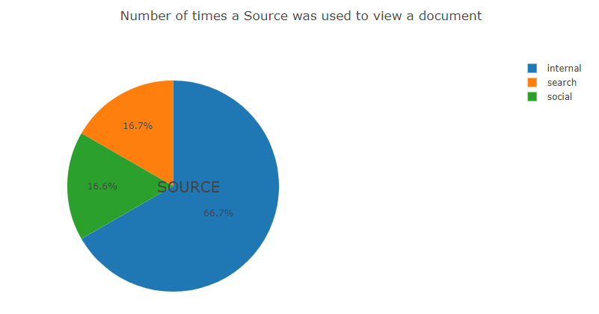
Visualize Shape Of Data on PageViews
Analyze the frequency of page views across different platforms
Analyze how traffic sources is related to accessing a page online.

Slide 11
List of AD’s for a particular display in decreasing order
As we are using display_id in this scenario and not document_id , we will be taking Promoted content and all the other files to create a single unified file, to take as many features as we can
clicks_train.csv
display_id | Single valued
ad_id | Single valued
clicked | Single valued
events_csv
display_id | Single valued
uuid | Single valued
document_id | Single valued
timestamp | Single valued
platform | Single valued
geo_location | Multi-valued
page_views_sample.csv
uuid | Single valued
document_id | Single valued
timestamp | Single valued
platform | Single valued
geo_location | Multi-valued
traffic_source | Single valued
documents_meta.csv
document_id | Single valued
source_id | Single valued
publisher_id | Single valued
publish_time | Single valued
promoted_content.csv
ad_id | Single valued
document_id | Single valued
campaign_id | Single valued
advertiser_id | Single valued

Slide 12
Result
For each display_id in the test set, predict a space-delimited list of ad_ids, ordered by decreasing likelihood of being clicked
{'display_id': ['ad_id_x'],
'98': ['102724', '102724', '127051', '127051', '127712', '127712', '163664', '163664', '190063', '190063', '5292', '5292'],
'979': ['233887', '68289'],
'962': ['141596', '152140'],
Random Forest Score

